Slide 1
Structured Programming Fundamentals
- Rishikesh Paudel

Slide 2
Today’s objective
If statement
If … else statement
Conditional statement ( ?: )
If … else if … else statement
Switch statement
While statement
Do … while statement
For statement
Nested if, while, for statements

Slide 3
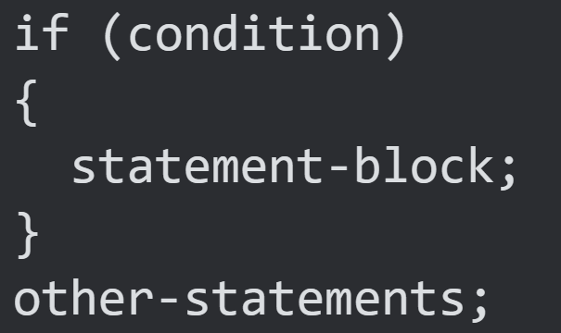
If Statement

Slide 4
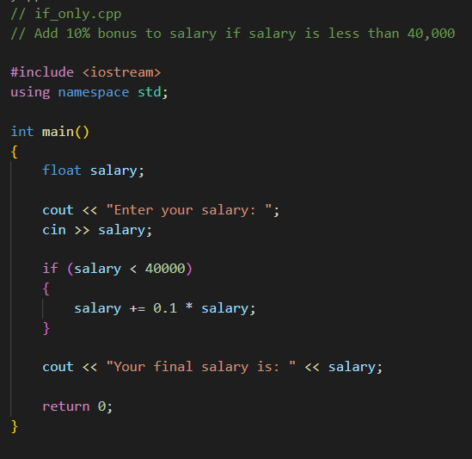



Slide 5
salary += 0.1 * salary
salary = salary + 0.1 * salary

Slide 6
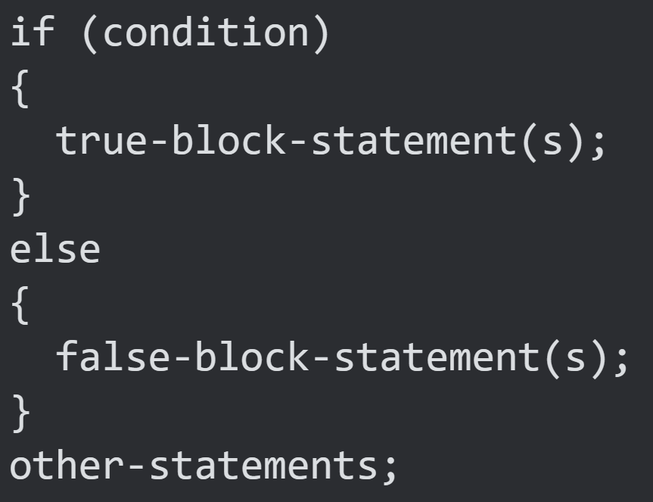
If…else statement

Slide 7
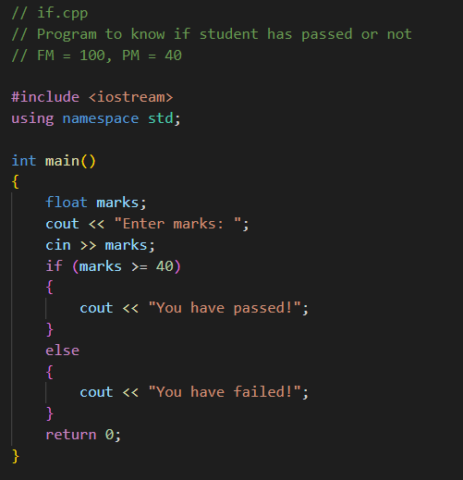



Slide 8
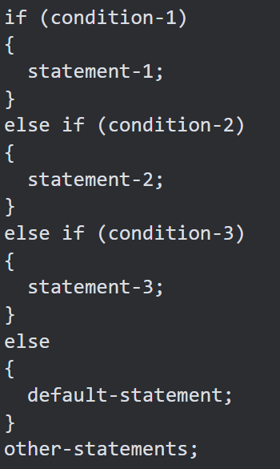
If…else if…else statement

Slide 9
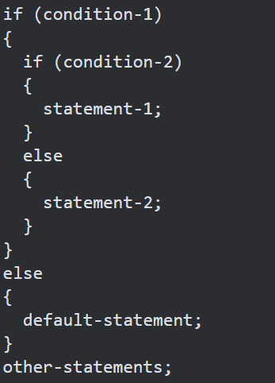
Nested if statement

Slide 10
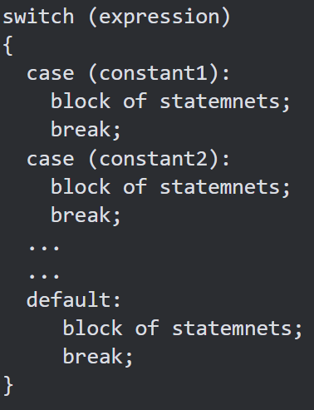
Switch statement

Slide 11
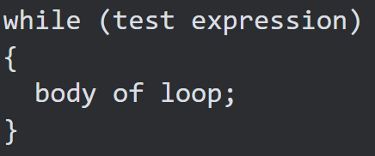
While loop

Slide 12
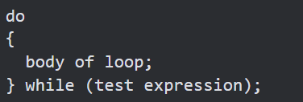
do…while loop

Slide 13
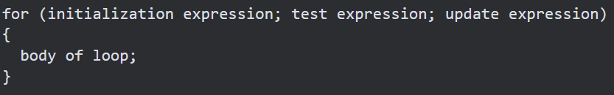
For loop

Slide 14

Nesting for and while loops

Slide 15
goto

Slide 16
Bibliography
Ram Datta Bhatta, “A Textbook of Object Oriented Programming”, Second Edition, Vidyarthi Pustak Bhandar
Krishna Kandel, “Learning C By Examples”, Seventh Edition, Shree Chandeswori Publication Pvt. Ltd.

